Slide 1
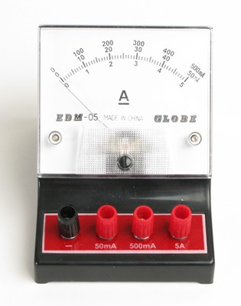
A Typical Meter has more than one scale
This meter has 3 scales
50mA
500mA
5A
The scale in use depends on how the meter is connected

Slide 2
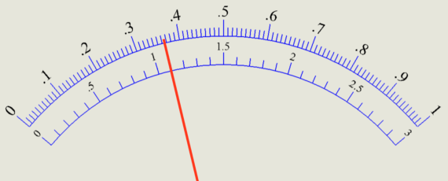
Reading a Voltmeter Scale
Determine the range.
What is the voltage if we are using the
0-1 A scale?

Slide 3
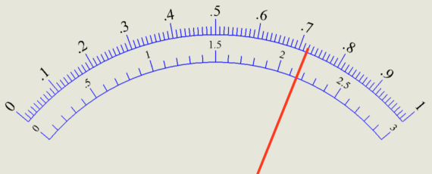
What is the voltage if we are using the
0-3 V scale?

Slide 4
Activity 1:
Connect the hand crank generator to the black and red terminals of the voltmeter.
Make the connections so that the 5V scale is in use
Turn the crank to create a steady voltage of 2.5V.
What is the precision of your voltage?
Let all members of your group try!

